Slide 1


JavaScript Data Structures
Objects with Methods, Nested Objects & JSON

Slide 2
Objects & Methods
Transforming static data into dynamic behavior.

Slide 3


What is an Object Method?
Functions as Properties
ES6 Shorthand
A method is simply a function definition stored as a property value in an object. It allows objects to perform "actions."
Modern JavaScript allows a cleaner syntax for defining methods without the function keyword or colon.
greet: function() { ... }
greet() { ... }

Slide 4
The Power of "this" Keyword
The keyword this refers to the owner of the method — the object itself.
Access internal properties: this.name
Dynamic context: this value depends on how the function is called.
Arrow functions do not have their own this binding.

Slide 5
Nested Objects
Modeling complex, real-world hierarchical data.

Slide 6

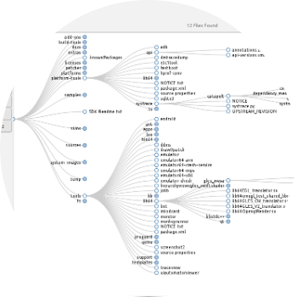
Hierarchical Structures
Object Composition
Objects can contain other objects as property values. This allows developers to group related data into logical sub-categories.
Example: A 'User' object containing an 'Address' object.

Slide 7





Accessing Nested Data
Dot Notation
Bracket Notation
Optional Chaining
Chain properties together for clean access: user.contact.email
Use when property names are dynamic: user['contact']['email']
Safely access deep properties without errors: user?.info?.age

Slide 8
JavaScript Object Notation
JSON: The universal language of data exchange.

Slide 9


JS Objects vs. JSON
JS Objects
JSON Format
An in-memory data structure for program logic. Supports methods, undefined, and unquoted keys.
A string-based data format for storage and transfer. Requires double quotes and has no methods.

Slide 10
Strict JSON Syntax Rules
Feature | JavaScript Object | JSON String
Keys | Unquoted or Quoted | Must be Double Quoted
Strings | Single or Double Quotes | Must be Double Quoted
Methods | Allowed | Not Allowed
Data Types | All (inc. undefined) | Limited (String, Num, Obj, Array)

Slide 11

The JSON Data Workflow
1. Create
2. Stringify
3. Transmit
4. Parse
Develop JS Object in memory.
Convert Object to JSON string.
Send string via Network API.
Convert string back to JS Object.

